Slide 1
OOPs Presentation
Karn Pratap Singh

Slide 2
Topics
Why is OOPs popular?
Difference b/w procedural & OOP
Encapsulation & Abstraction (With examples)
Inheritance and it’s types
Diamond Problem
Polymorphism & it’s types (With examples)

Slide 3
Why is OOPs popular?
Major reasons for popularity of OOPs:
- Reuse of code through inheritance
- Flexibility through polymorphism

Slide 4
Difference b/w Procedural & OOP paradigm
- Based upon the concept of calling procedures. It follows a step-by-step approach to execute a program.
- Methodology that organizes software design around data or objects.
- Less secure
- Data hiding is possible
- There is no code reusability
- There is code reusability using inheritance
- There are no access modifiers in procedural programming.
- The access modifiers in OOP are named as private, public, and protected
- Follows top-down approach
- Follows bottom-up approach

Slide 5
Top-Down Vs Bottom-Up
- An overview of the system is formulated without much specific details .
- Individual parts of the system are specified in details.
- A complex algorithm is broken down into smaller fragments, better known as ‘modules.’
- Focuses on designing an algorithm by beginning at the very basic level and building up as it goes.
- Advantages: Breaking a problem down into smaller chunks makes it far easier to understand, solve and manage.
- Advantages: less redundancy (because of data hiding) and reusability of code
NOTE: Specification tends to change over time and in a top-down approach, all decisions made from the beginning of the project depend directly or indirectly on the high-level specification.

Slide 6
Encapsulation & Abstraction
Encapsulation:
Bundling of data with methods
Restricting of direct access to some of an object's components.
Abstraction:
-Hiding the unnecessary details from the users
Note: A combination of data hiding and abstraction is nothing but encapsulation

Slide 7
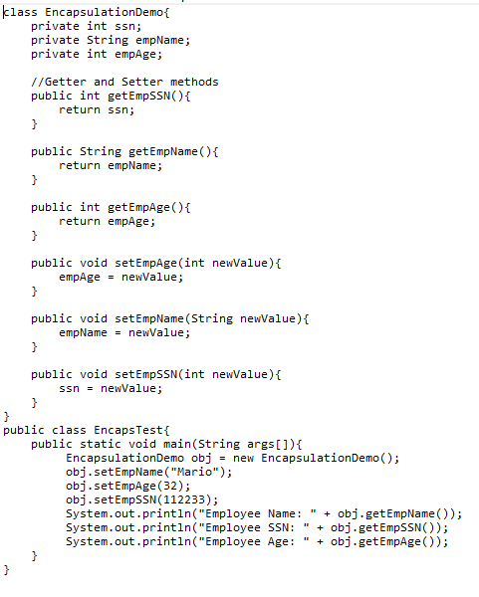
Example of Encapsulation

Slide 8
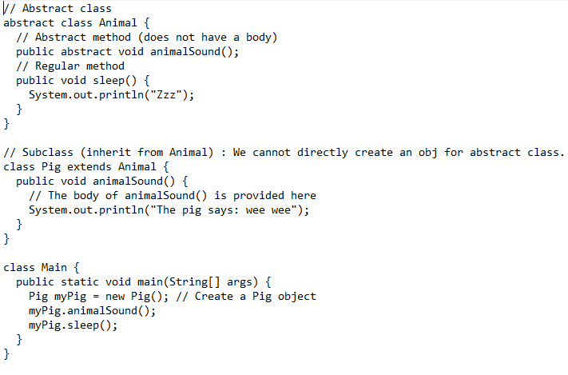
Example of Abstraction

Slide 9
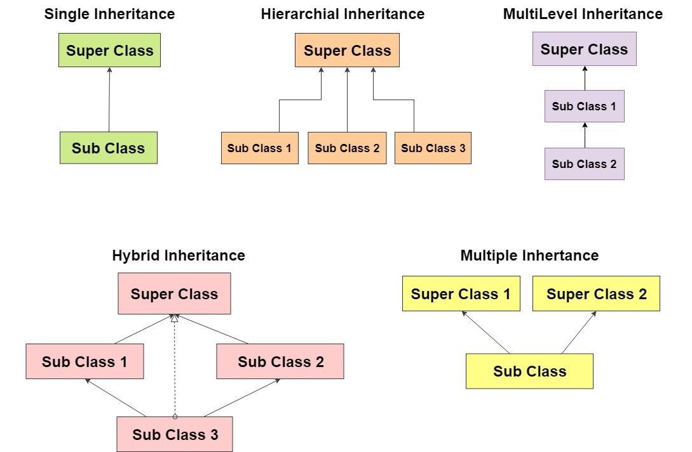
Inheritance & it’s types
Definition: Inheritance is a mechanism of acquiring the features and behaviors of a class by another class. Types are as follows:
Notes:
Hybrid is a combination of 2 or more inheritance types.
Disadvantage of inheritance: Any change in base class will affect the derived classes.

Slide 10
Some key points about Inheritance
Hybrid is a combination of 2 or more inheritance types.
Disadvantage of inheritance: Any change in base class will affect the derived classes.
Inheritance follows Is-a relationship.(Next slide)

Slide 11
IS-A & HAS-A relationship
IS-A
HAS-A
-The concept of IS-A is based on Inheritance. It is just like saying "A is a B type of thing". For example, Apple is a Fruit. Inheritance is uni-directional. For example, House is a Building. But Building is not a House.
It uses extends keyword or implements keyword.
- Has-A relationship simply means that an instance of one class has a reference to an instance of another class or an other instance of the same class.

Slide 12
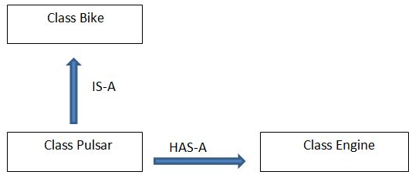
Example:

Slide 13
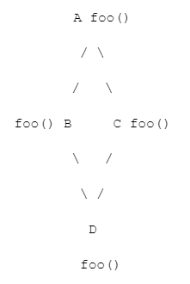
Why Java does not support Multiple Inheritance?
- Ambiguity around the Diamond problem:
Consider a class A has foo() method and then B and C derived from A and has their own foo() implementation, and now class D derives from B and C using multiple inheritance and if we refer just foo() compiler will not be able to decide which foo() it should invoke.

Slide 14
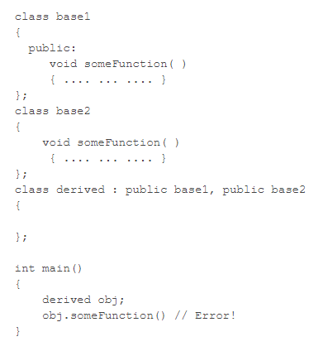
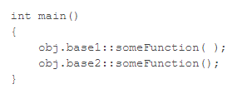
C++ supports Multiple Inheritance
This problem can be solved using scope resolution(::) function to specify which function to class either base1 or base2

Slide 15
Polymorphism & it’s types
Polymorphism: Program behaves differently under different circumstances.
Two of polymorphisms are:
Compile Time / Static Binding / Method Overloading Polymorphism:
Happens at compile time. What it means is that the compiler decides how the program will behave.
Run Time/ Dynamic Binding / Method Overriding Polymorphism:
Happens at the run time. What it means is it can't be decided by the compiler. Therefore the behavior of program depends upon the execution. Hence the name Runtime Polymorphism.
Notes:
Code example.

Slide 16
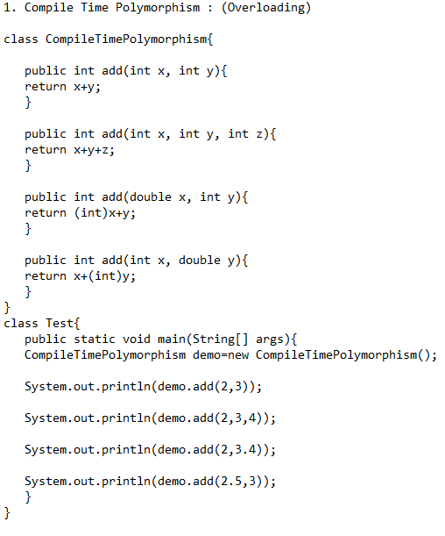
Function Overloading Example:

Slide 17
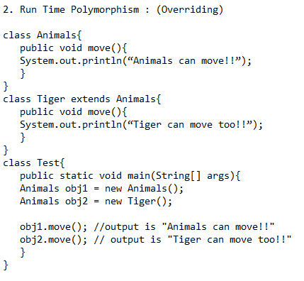
Function Overriding Example:

